Slide 1
Stack Organization and Notations
(Lecture 22-23)

Slide 2
Introduction
Stack is also known as the Last In First Out (LIFO) list. It is the most important feature in the CPU. It saves data such that the element stored last is retrieved first. A stack is a memory unit with an address register that can count only. The register that holds the address for the stack is called a stack pointer (SP) because its value always points at the top item in the stack.). The stack pointer continually influences the address of the element that is located at the top of the stack.
It can insert an element into or delete an element from the stack. The insertion operation is known as push operation and the deletion operation is known as pop operation. In a computer stack, these operations are simulated by incrementing or decrementing the SP register.

Slide 3
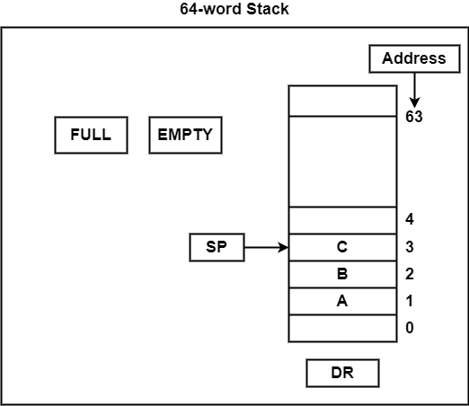
Registered Stack
Register Stack
The stack can be arranged as a set of memory words or registers. Consider a 64-word register stack arranged as displayed in the figure.
The element C is at the top of the stack and the stack pointer holds the address of C that is 3. The top element is popped from the stack through reading memory word at address 3 and decrementing the stack pointer by 1. Then, B is at the top of the stack and the SP holds the address of B that is 2. It can insert a new word, the stack is pushed by incrementing the stack pointer by 1 and inserting a word in that incremented location.

Slide 4
Push Operation
Initially, SP is cleared to 0, EMTY is set to 1, and FULL is cleared to 0, so that SP points to the word at address 0 and the stack is marked empty and not full. If the stack is not full (if FULL = 0), a new item is inserted with a push operation.
The push operation is implemented with the following sequence of
microoperations;
SP <- SP + 1
M [SP] <- DR
If (SP = 0) then (FULL <--1)
EMTY <--0
1. Increment stack pointer
2. Write item on top of the stack
3. Check if stack is full
4. Mark the stack not empty
(The first item stored in the stack is at address L The last item is stored at address 0. If SP reaches 0, the stack is full of items, so FULL is set to L This condition is reached if the top item prior to the last push was in location 63 and, after incrementing SP, the last item is stored in location 0. Once an item is stored in location 0, there are no more empty registers in the stack.)

Slide 5
Pop Operation
The stack pointer is incremented so that it points to the address of the next-higher word. A memory write operation inserts the word from DR into the top of the stack. Note that SP holds the address of the top of the stack and that M [SP] denotes the memory word specified by the address presently available in SP.
A new item is deleted from the stack if the stack is not empty (if EMTY = 0).
The pop operation consists of the following sequence of microoperations.
DR <--M [SP]
SP <--SP - 1
If (SP = 0) then (EMTY <--1)
FULL <--0
1. Read item from the top of stack
2. Decrement stack pointer
3. Check if stack is empty
4. Mark the stack not full

Slide 6
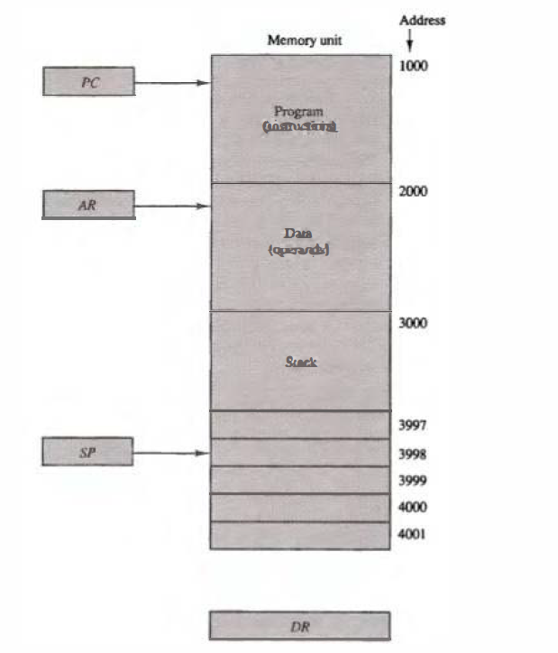
Memory Stack implemented in a RAM attached to a CPU
Memory Stack
A stack can exist as a stand-alone unit as in last section or can be implemented in a RAM attached to a CPU. The implementation of a stack in the CPU is done by assigning a portion of memory to a stack operation and using a register as a stack pointer as shown in the figure where PC is used during the fetch phase to read an instruction. AR is used during the execute phase to read an operand. SP is used to push or pop items into or from the stack.
Suppose the initial value of SP is 4001 and the stack grows with decreasing addresses. Thus the first item stored in the stack is at address 4001 , the second item is stored at address 4000, and the last address that can be used for the stack Is 3000.

Slide 7
Advantages of Stack implemented in a RAM attached to a CPU
Most computers do not provide hardware to check for stack overflow (full stack) or underflow (empty stack). The stack limits can be checked by using two registers: one to hold the upper limit (3000 in this case), and the other to hold the lower limit (4001 in this case). After a push operation, SP is compared with the upper-limit register and after a pop operation, SP is compared with the lower-limit register.
Advantages:-
CPU can refer to memory stack without having to specify an address, since the address is always available and automatically updated in the stack pointer.
Memory stack can potentially provide a larger storage space compared to register stack. Registers are limited in number and size, whereas memory stack can use the entire available RAM, which is significantly larger
A new item is inserted with the push operation as follows:
SP <-SP - 1
M[SP] <-DR
A new item is deleted with a pop operation as follows:
DR <-M[SP]
SP <-SP + 1

Slide 8
Polish(Prefix) and Reverse Polish (Postfix) Notation
Polish Notation (Prefix)
The Polish mathematician Lukasiewicz showed that arithmetic expressions can be represented in prefix notation . This representation, often referred to as Polish notation, places the operator before the operands.
The postfix notation, referred to as Reverse Polish notation (RPN), places the operator after the operands.
The following examples demonstrate the three representations:
A + B Infix notation
+ AB Prefix or Polish notation
AB + Postfix or reverse Polish notation
The reverse Polish notation is in a form suitable for stack manipulation.

Slide 9
Reverse Polish Expressions
Steps to evaluate reverse polish expression:-
1. Scan the expression from left to right. When an operator is reached, perform the operation with the two operands found on the left side of the operator. Remove the two operands and the operator and replace them by the number obtained from the result of the operation.
2. Continue to scan the expression and repeat the procedure for every operator encountered until there are no more operators.
e.g. AB • CD • +
For the above expression we find the operator • after A and B. We perform the operation A • B and replace A, B, and • by the product to obtain (A • B) CD • +
where (A • B) is a single quantity obtained from the product. The next operator is a • and its previous two operands are C and D, so we perform C • D and
obtain an expression with two operands and one operator: (A • B) (C • D) +
The next operator is + and the two operands to be added are the two products,
so we add the two quantities to obtain the result.
Example: Input: ["2", "1", "+", "3", "*"], Output: 9

Slide 10
Conversion of infix to postfix
Conversion of infix to postfix
Here, we will use the stack data structure for the conversion of infix expression to prefix expression. Whenever an operator will encounter, we push operator into the stack. If we encounter an operand, then we append the operand to the expression.
Rules for the conversion from infix to postfix expression
Print the operand as they arrive.
If the stack is empty or contains a left parenthesis on top, push the incoming operator on to the stack.
If the incoming symbol is '(', push it on to the stack.
If the incoming symbol is ')', pop the stack and print the operators until the left parenthesis is found.
If the incoming symbol has higher precedence than the top of the stack, push it on the stack.

Slide 11
Conversion of infix to postfix (Cont..)
6. If the incoming symbol has lower precedence than the top of the stack, pop and print the top of the stack. Then test the incoming operator against the new top of the stack.
7. If the incoming operator has the same precedence with the top of the stack then use the associativity rules. If the associativity is from left to right then pop and print the top of the stack then push the incoming operator. If the associativity is from right to left then push the incoming operator.
8. At the end of the expression, pop and print all the operators of the stack.

Slide 12
Conversion of infix to postfix (Cont..)
Let's understand through an example.
Convert the following infix expression into postfix expression.
Infix expression: K + L - M*N + (O^P) * W/U/V * T + Q
The final postfix expression is KL+MN*-OP^W*U/V/T*+Q+.

Slide 13
Conversion of infix to postfix (Cont..)
Input Expression | Stack | Postfix Expression
K |  | K
+ | +
L | + | K L
- | - | K L+
M | - | K L+ M
* | - * | K L+ M
N | - * | K L + M N
+ | + | K L + M N* K L + M N* -
( | + ( | K L + M N *-
O | + ( | K L + M N * - O
^ | + ( ^ | K L + M N* - O
P | + ( ^ | K L + M N* - O P
) | + | K L + M N* - O P ^
* | + * | K L + M N* - O P ^
W | + * | K L + M N* - O P ^ W
/ | + / | K L + M N* - O P ^ W *
U | + / | K L + M N* - O P ^W*U
/ | + / | K L + M N* - O P ^W*U/
V | + / | KL + MN*-OP^W*U/V
* | + * | KL+MN*-OP^W*U/V/
T | + * | KL+MN*-OP^W*U/V/T
+ | + | KL+MN*-OP^W*U/V/T* KL+MN*-OP^W*U/V/T*+
Q | + | KL+MN*-OP^W*U/V/T*Q
 |  | KL+MN*-OP^W*U/V/T*+Q+

Slide 14
Conversion from postfix to infix
Algorithm 1.While there are input symbol left …1.1 Read the next symbol from the input. 2.If the symbol is an operand …2.1 Push it onto the stack.
3.Otherwise,
…3.1 the symbol is an operator. …3.2 Pop the top 2 values from the stack. …3.3 Put the operator, with the values as arguments and form a string. …3.4 Push the resulted string back to stack. 4.If there is only one value in the stack …4.1 That value in the stack is the desired infix string. Below is the implementation of above approach:

Slide 15
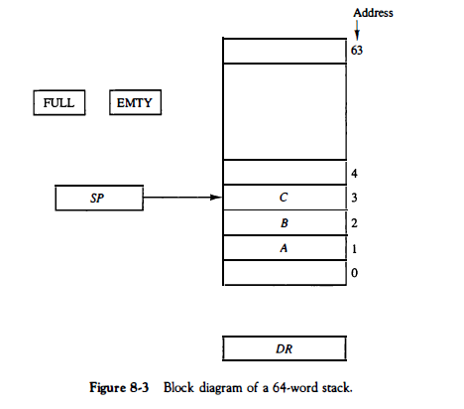
Problems
Q.no. 8.5(M.M.) Let SP=000000 in the stack of Fig. 1 How many items are there in the stack if:
FULL= 1 and EMTY = 0?
b. FULL = 0 and EMTY = 1?
Q.no. 8.5(M.M.) A stack is organized such that SP always points at the next empty location on the stack. This means that SP can be initialized to 4000 in Fig. 2 and the first item in the stack is stored in location 4000. List the microoperations for the push and pop operations.

Slide 16
Problems
8-7. Convert the following arithmetic expressions from infix to reverse Polish
notation.
a. A • B + C • D + E • F
b . A • B + A • (B • D + C • E)
c. A + B • [C • D + E • (F + G)]
d. [A • {B + C • (D + E)}]/[f • (G + H)]
8-8. Convert the following arithmetic expressions from reverse Polish notation to infix notation.
a. A B C D E + • - I
b. A B C D E • l - +
c. A B C • l D - E F I +
d. A B C D E F G + • + • + •
8-9. Convert the following numerical arithmetic expression into reverse Polish notation and show the stack operations for evaluating the numerical result.
(3 + 4)[10(2 + 6) + 8]

Slide 17
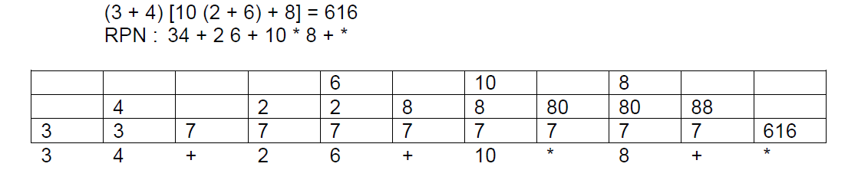
Solutions

Slide 18
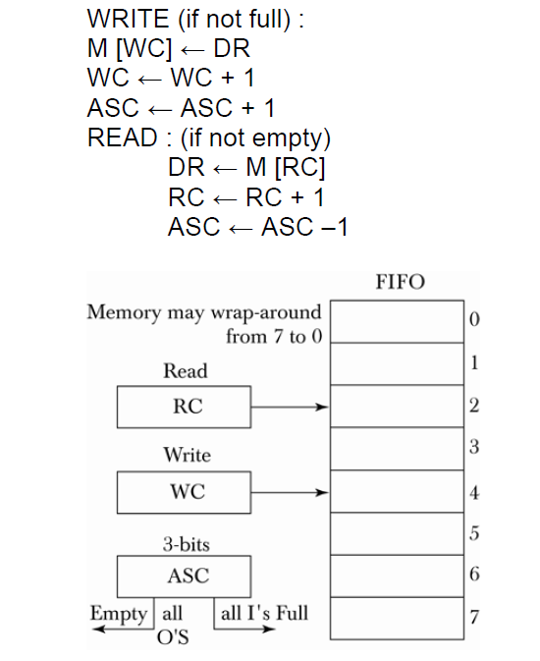
Problems
8-10. A first-in1 first-out (FIFO) has a memory organization that stores information in such a manner that the item that is stored first is the first item that is retrieved. Show how a FIFO memory operates with three counters. A write counter WC holds the address for writing into memory. A read counter RC holds the address for reading from memory. An available storage counter ASC indicates the number of words stored in FIFO. ASC is incremented for every word stored and decremented for every item that is retrieved.

